Slide 1
EECS 498 System Design of a Search Engine
Winter 2026
Lab 1: Speed dating
Nicole Hamilton
https://web.eecs.umich.edu/~nham/
nham@umich.edu

Slide 2
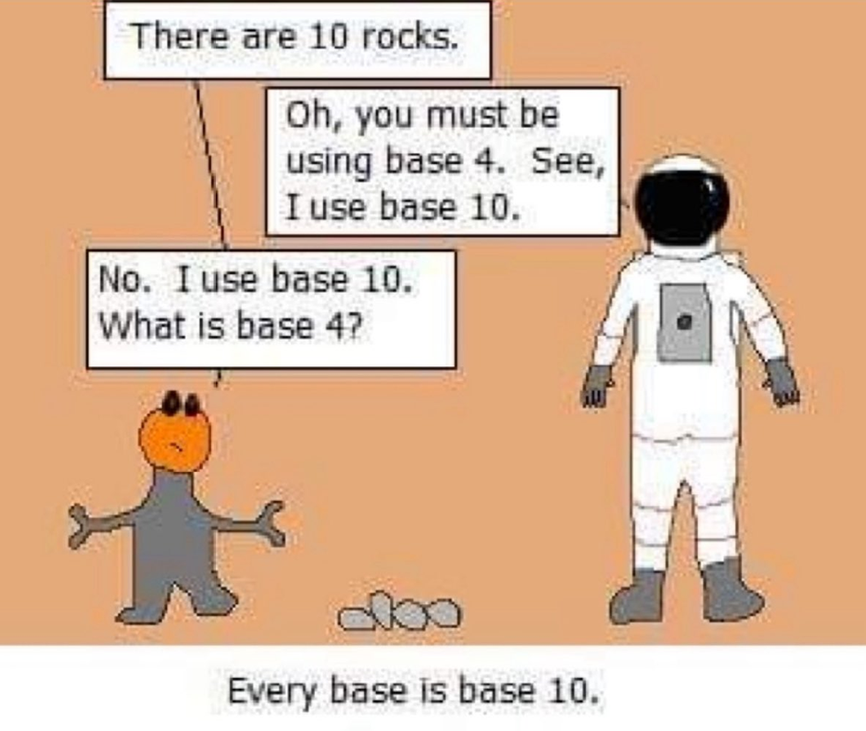

Slide 3
agenda
Administrivia
What we’ll do in the labs
Finish up yesterday’s lecture.
Speed dating

Slide 4
agenda
Administrivia
What we’ll do in the labs
Finish up yesterday’s lecture.
Speed dating

Slide 5
administrivia
The autograder tests of the performance of MostPositiveSubsequence and of a sample output from BestSequence were accidentally set private.
They are now public.

Slide 6
agenda
What we’ll do in the labs
Speed dating

Slide 7
agenda
Administrivia
What we’ll do in the labs
Finish up yesterday’s lecture.
Speed dating

Slide 8
what we’ll do here
Think of this as grown-up study hall.
The purpose is for a team meeting.
Everyone on a team has to be in the same section.
No one is supposed to have any schedule conflicts.
So, everyone is supposed to be able to meet for 2 hours.
You’ll also get help and periodic checkins with the staff.
Most of W25, I just played music while the teams worked.
Occasionally, we’ll have actual content, e.g., overflow from lectures or tutorial material explaining an assignment.

Slide 9
agenda
Administrivia
What we’ll do in the labs
Finish up yesterday’s lecture.
Speed dating

Slide 10
agenda
Administrivia
What we’ll do in the labs
Finish up yesterday’s lecture.
Speed dating

Slide 11
speed dating
You need to find teammates and do it quickly.
The difference between on a strong team versus a weak team is the difference between an A and a B.
So, it matters who you pick for your team.
Today, we do speed-dating.
Break up in small groups of 3 or 4 for a short 5-to-10-minute discussion.
Collect some results.
Form new groups with people you haven’t met yet and repeat.

Slide 12
What would you like to know about someone to know if they’re a good match?

Slide 13
We need a cartoon mascot for a class tee shirt. What animal should it be?

Slide 14
Are there ways you might use AI ethically and productively in a class like this?

Slide 15
How could you decide whether a link is worth crawling or a page is worth indexing?

Slide 16
When you look at search result, how do you decide whether it’s a good match?

Slide 17
When you look at search result, how do you decide whether it’s a good match?

Slide 18
If you distribute your engine across a lot of machines, should it have a master?

Slide 19
What do you think will be the hardest part of building the engine?

